Slide 1
Series Animations
With Motion UI
Abby Poplawski

Slide 2
Overview
Series animations let you take multiple elements and string their animations in a set order
This allows for a smooth, multifaceted animation without a big chunk of separate animation classes
Can be used for a loading animation or an animation on the home page that draws attention

Slide 3
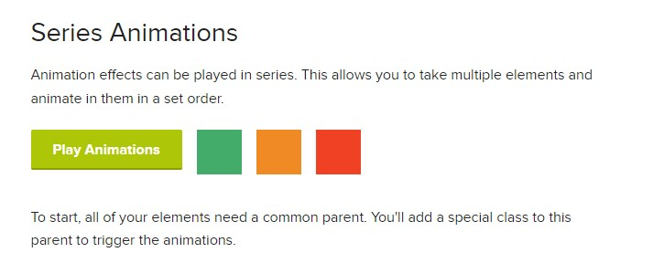
Example

Slide 4
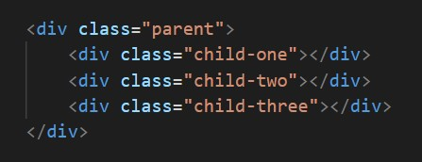
Basic Set Up
Wrap the elements being animated inside a parent container

Slide 5
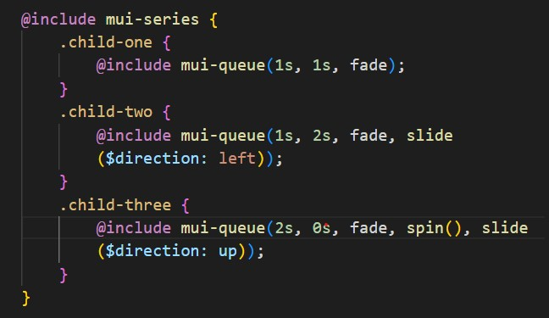
Add Mui-series Mixin
Add the mui-series mixin, then add mui-queue to child element classes

Slide 6
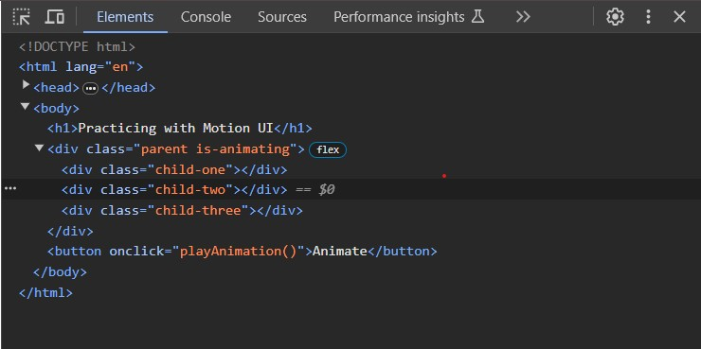
Add Animating Class
Either hard code the animating class to the parent element or toggle it with JavaScript

Slide 7
mui-series()
Creates a new animation queue
Parameters
delay – delays the start of the animation in seconds or milliseconds
Default : 0s

Slide 8
mui-queue()
Adds an animation to an animation queue. Can only be used inside mui-series()
Parameters
duration – length of the animation (Default : 1s)
gap – amount of time to pause before playing the animation after this one (Default: 0s)
keyframes – one or more effect functions to build the keyframe with

Slide 9
Functions
Several functions allow you to customize the keyframes parameter in the mui-queue
fade()
hinge()
shake()
slide()
spin()
wiggle()
zoom()

Slide 10
Sources
https://zurb.com/playground/motion-ui
https://github.com/foundation/motion-ui/blob/master/docs/animations.md

Slide 11
Thank you
Any Questions?

